Slide 1
Topic 09B HTTP

Slide 2
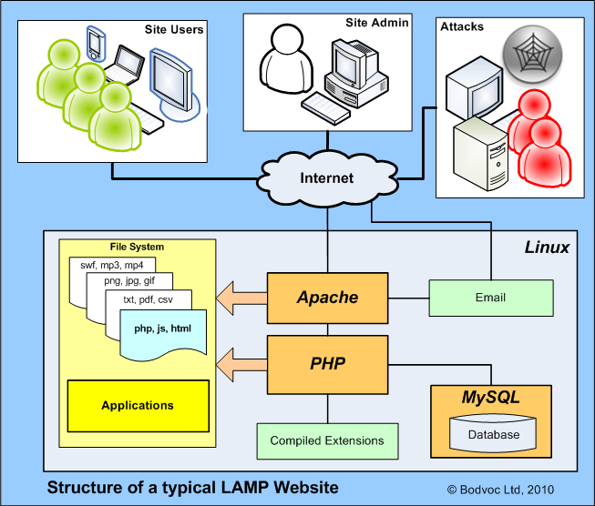
Sample Web Application
Notes:
What are the functions of the principal components?
Linux
The Linux operating system provides the platform for secure and reliable operation of the web server. Access to the file system is governed by file permissions and enforced by the operating system. The operating system also provides interfaces to the networks and enforces process and user security.
Apache
When a user requests a page or content from the web server, Apache receives the HTTP Request and interprets the contents. For example, Apache will determine whether a file extension has been supplies as part of the Request. If so it will determine whether the requested resource is a static items, e.g. a simple web page stored as an HTML file, or whether the requested item relates to an application, e.g. a PHP file. Depending on the complexity of the requested item, Apache may be required to locate and respond with a number of resources, e.g. the basic HTML file, CSS files, Javascript, images and other media like MP3 audio files of SWF video files. Apache determines where to locate the content based on the path specified in the HTTP Request and the file paths identified in the HTML content.
PHP
Increasingly users expect to be provided wuth dynamic content, which may be influenced by time, current events, the user’s location or personalisation. With these more complex websites, static HTML pages are largely replaced by applications. One of the most popular scripting languages is PHP and there are a wide range of applications available including content management systems (CMS) like Joomla!, forums, bulletin boards, shopping carts, etc.
For a dynamic site, the Apache web server is configured to recognise when a script needs to be run, this may be through a combination of file extensions and default settings. For example, if a website’s home page is requested and the server has PHP installed, Apache will seek an index.php file in the root directory if there is no index.html file in the website root directory. It is this mechanism which is used to initialise applications like Joomla! The PHP scripts will be used to store and retrieve information and to render the HTML page layouts for transmission back to the user’s browser by the Apache web server.
MySQL
Typically a PHP website will also use a MySQL database to store content and configuration information. It is possibel to build sites where the contents are storeed in flat text files, but the use of relational databses like MySQL gives greater flexibility. The interaction between the Apache webserver and the MySQL database is handled by PHP.
Other Components
There may be a number of other components and applications hosted on the server. These may include compiled applications for delivery of specialist media or graphic content, or for rendering images and animations. A common application on Linux servers is email and this may be provided with a web mail interface via Apache and/or direct connections using POP ans SMTP protocols.

Slide 3

What is LAMP?
https://tecadmin.net/install-lamp-stack-on-ubuntu-18-04/

Slide 4
Web Server
HTTPD - Apache2 Web Server
Apache is the most commonly used Web server on Linux systems. Web servers are used to serve Web pages requested by client computers. Clients typically request and view Web pages using Web browser applications such as Firefox, Opera, Chromium, or Internet Explorer.
Users enter a Uniform Resource Locator (URL) to point to a Web server by means of its Fully Qualified Domain Name (FQDN) and a path to the required resource. For example, to view the home page of the Ubuntu Web site a user will enter only the FQDN:
www.ubuntu.com
To view the community sub-page, a user will enter the FQDN followed by a path:
www.ubuntu.com/community
The most common protocol used to transfer Web pages is the Hyper Text Transfer Protocol (HTTP). Protocols such as Hyper Text Transfer Protocol over Secure Sockets Layer (HTTPS), and File Transfer Protocol (FTP), a protocol for uploading and downloading files, are also supported.
Apache Web Servers are often used in combination with the MySQL database engine, the HyperText Preprocessor (PHP) scripting language, and other popular scripting languages such as Python and Perl. This configuration is termed LAMP (Linux, Apache, MySQL and Perl/Python/PHP) and forms a powerful and robust platform for the development and deployment of Web-based applications.https://help.ubuntu.com/lts/serverguide/httpd.html

Slide 5
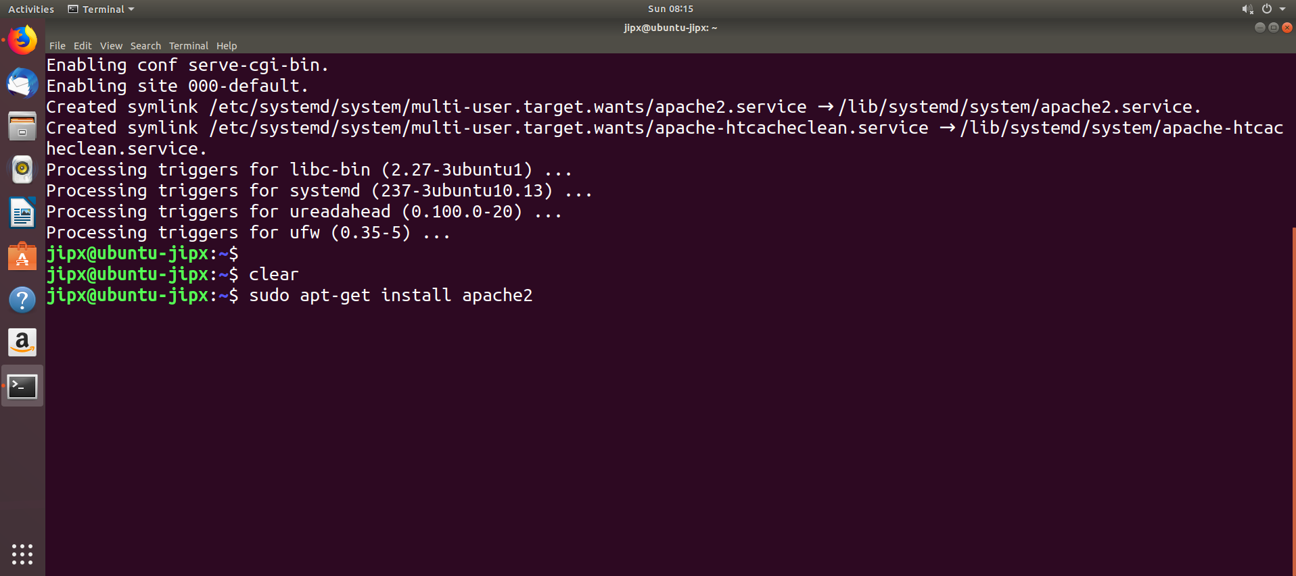
Install Apache web server
Install the HTTP server the command
sudo apt-get update sudo apt-get install apache2
Check to see if apache2 service is running: sudo systemctl status apache2

Slide 6
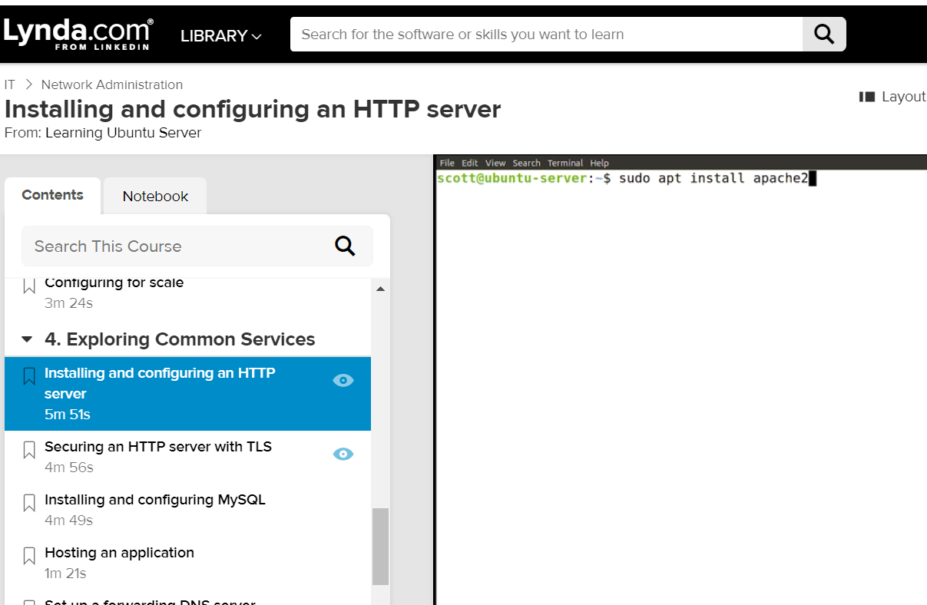
HTTPd
Install httpd
Put your desired content into /var/www/html
restorecon –rv /var/www/html to fix selinux context
Edit /etc/httpd/conf/httpd.conf
Notes:
A common use for a server is to host a web page or web application. To do this we need to install an http server package. In this video, I'll show you how to install and configure the Apache http server on an Ubuntu server. To start with, we'll need to install the software from the repositories. And to do that I'll write apt install apache2. This will install the software we need, set up the configuration and folders, and start up the service. (keyboard clicking) Let's take a look at the service.
Looks like it's running. On Ubuntu, the configuration for Apache is broken up over a few files.Technically, these all act as one file because the primary file includes or calls the others. But having them broken up helps readability and maintainability. In fact, if we take a look at that file, there's a little diagram of how the files are included. Conf files are pieces of the configuration file. And the ones located in the sites available folder are the configuration files we created to find the site.
When they're made active, they get linked into the site's enabled folder and the web server will interpret them. This apache2.conf holds global settings for the server and for all the sites.And the individual files are intended to hold individual sites or configurations. So let's take a look at those individual files. Here in the etc apache2 sites available folder, there are two files that come predefined.
There's 000-default.conf, and default-ssl.conf. The first one defines a standard website. And the second one defines an ssl or tls protected one, which takes a little bit of setup. Let's take a look at the 000-default file first. In this file, as I mentioned before, is a fragment of configuration for the web server. So it contains a block of code essentially, that Apache interprets. This code block is a virtual host definition.
A virtual host allows Apache to host more than one website on the same server, even on the same IP address. This is a common way of setting up web servers. When a request for a website comes into such a web server, Apache reads the server name, and determines which site to serve. This virtual host is set to respond to any address on the server on port 80. We can see that here in the server name directive. My server doesn't have a name. So right now it will respond to any address on the system at port 80.
If you do have a domain name, or have a DNS entry set up for your server, you can put it in the server name directive and then Apache will resolve that site name to this particular configuration file. You'll also need to have appropriate DNS entries, especially an A record if you're hosting a website either at your domain registrar, or on a DNS server of your own.Typically a domain registrar will make this fairly easy. Your domain name needs to point to the IP address of your server. Otherwise, browsers won't be able to find the site.
Further down in the configuration, we can set a contact email address for the site administrator and then we specify what folder in the system is the document root. That is, what folder gets served up by the web server for this particular site. It's set to var www html, which was created when Apache was installed. Other sites would need different folders, with appropriate permissions set on them. The folders that Apache serves need to be accessibleto it or to root. So if you add files or folders, you may need to double-check or reset the permissions for them.
Below the document root, we can add directives to control particular directories. But we'll keep it basic for now. Take at look at our courses on Apache administration for more detail on that. And we can control the detail of the logs that Apache generates, and what their particular format will be. Okay, I haven't made any changes here. So I'll just quit the editor.Had I made changes, I'd need to restart the apache2 service for those changes to take effect.And if I created a new site, I'd need to enable it with a2ensite and the name of the configuration.
But again, this one's already enabled. Let's go take a look at what's inside that folder that was defined as the document root. Here's a basic file that represents a default site, a page that basically shows that Apache is running. If I visit the server's address in a web browser, these are the files that will be served, starting with index.html. If you're going to be deploying a website, this folder is where you'll probably put those files. You can use a different folder by setting a different document root path.
And you may need to install modules to support things you'll use, like vhp. But for now, we'll stick with the placeholder site that comes with the install just to see that it works. The web server runs on port 80, so we'll need to open up access on the firewall to allow other people to see the site. Let's open up the web browser and browse to the IP address of our site. Okay, there's that index.html document. There's a lot to learn about Apache, but the basics are pretty straightforward, especially if you're hosting one site.
The 000 default site runs on port 80. So as I mentioned before, it's not secured. This might be fine for an internal facing site. But for anything appearing on the public web, you should consider setting up a secured site with tls.
Source: https://www.lynda.com/Linux-tutorials/Installing-configuring-HTTP-server/718668/779183-4.html?org=sp.edu.sg

Slide 7
HTTPd
Common options in config file
DirectoryIndex - Determine file that is the index
DocumentRoot - The base of the content folder
<Directory /> - Directive determined by the directory
Read more https://help.ubuntu.com/lts/serverguide/httpd.html.en-GB#http-directory-permissions
Notes:
Default Settings
This section explains configuration of the Apache2 server default settings. For example, if you add a virtual host, the settings you configure for the virtual host take precedence for that virtual host. For a directive not defined within the virtual host settings, the default value is used.
The DirectoryIndex is the default page served by the server when a user requests an index of a directory by specifying a forward slash (/) at the end of the directory name. For example, when a user requests the page http://www.example.com/this_directory/, he or she will get either the DirectoryIndex page if it exists, a server-generated directory list if it does not and the Indexes option is specified, or a Permission Denied page if neither is true. The server will try to find one of the files listed in the DirectoryIndex directive and will return the first one it finds. If it does not find any of these files and if Options Indexes is set for that directory, the server will generate and return a list, in HTML format, of the subdirectories and files in the directory. The default value, found in /etc/apache2/mods-available/dir.conf is "index.html index.cgi index.pl index.php index.xhtml index.htm". Thus, if Apache2 finds a file in a requested directory matching any of these names, the first will be displayed.
The ErrorDocument directive allows you to specify a file for Apache2 to use for specific error events. For example, if a user requests a resource that does not exist, a 404 error will occur. By default, Apache2 will simply return a HTTP 404 Return code. Read /etc/apache2/conf-available/localized-error-pages.conf for detailed instructions for using ErrorDocument, including locations of example files.
By default, the server writes the transfer log to the file /var/log/apache2/access.log. You can change this on a per-site basis in your virtual host configuration files with the CustomLog directive, or omit it to accept the default, specified in /etc/apache2/conf-available/other-vhosts-access-log.conf. You may also specify the file to which errors are logged, via the ErrorLog directive, whose default is /var/log/apache2/error.log. These are kept separate from the transfer logs to aid in troubleshooting problems with your Apache2 server. You may also specify the LogLevel (the default value is "warn") and the LogFormat (see /etc/apache2/apache2.conf for the default value).
https://help.ubuntu.com/lts/serverguide/httpd.html.en-GB#http-directory-permissions

Slide 8
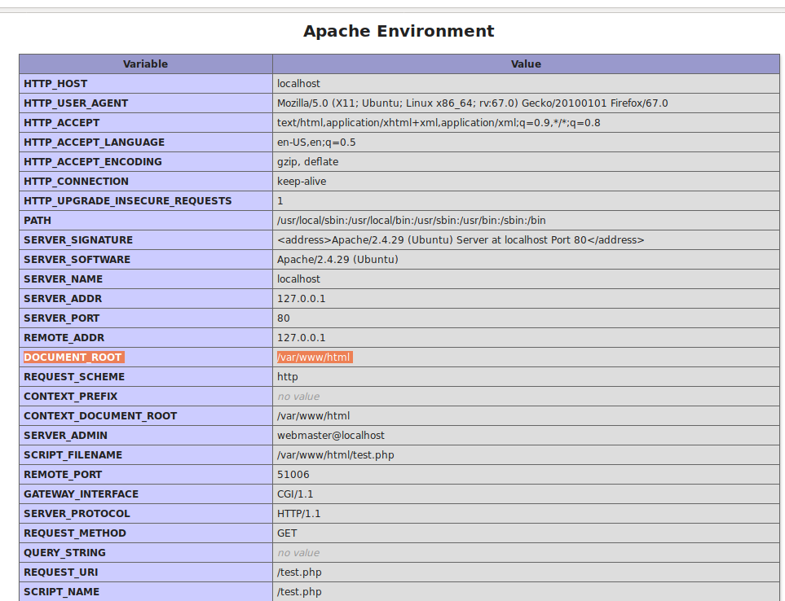
DOCUMENT_ROOT /var/www/html
Notes:
Apache has DocumentRoot directive.
This directive sets the directory from which Apache will serve files. Unless matched by a directive like Alias, the server appends the path from the requested URL to the document root to make the path to the document. Example:
DocumentRoot /var/www/html
then an access to http://www.abc.com/index.html refers to /var/www/html/index.html.

Slide 9
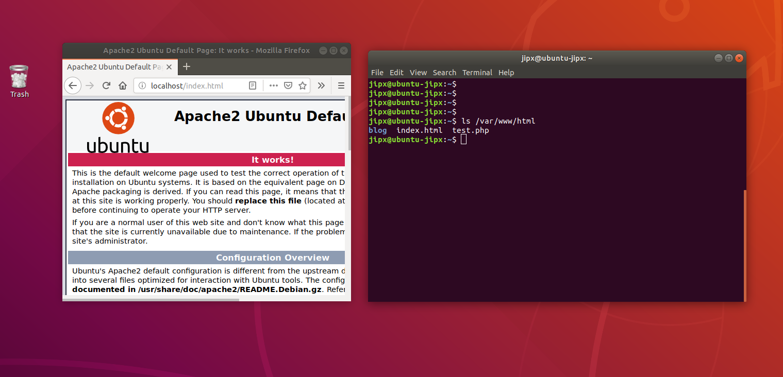
DocumentRoot /var/www/html
then an access to http:/localhost/index.html refers to /var/www/html/index.htm

Slide 10
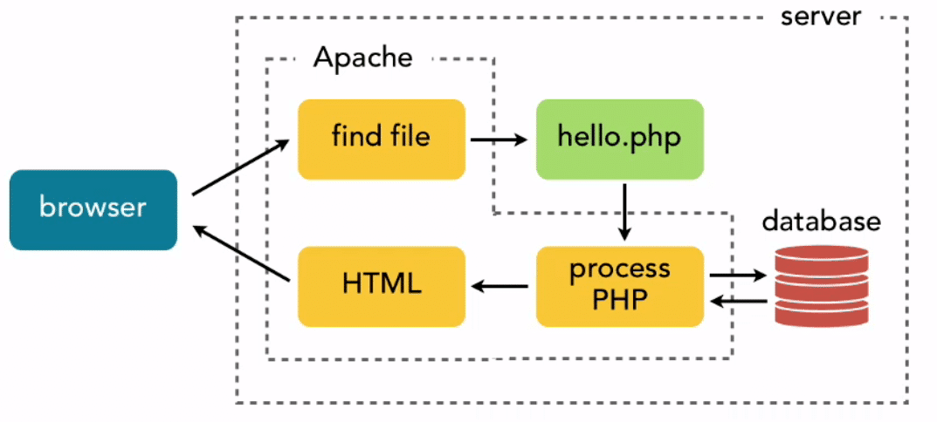
What Apache needs to Run Php File?
Running Php files on Apache needs mod_php enabled on your server. It allows Apache to interpret .Php files. It has Php handlers that interpret the Php code in apache and send HTML to your web server.
If mod_php is enabled on your server, you will have a file named php.conf in /etc/httpd/conf.d/ directory. You can also check it with:
httpd -M | grep "php5_module"
https://geekflare.com/php-fpm-optimization/
Notes:
Interestingly, when the browser sends a request to a server running PHP, it’s not PHP that forms the point the first contact; instead, it’s the HTTP server, the major ones of which are Apache and Nginx. These “web servers” then have to decide how to connect to PHP, and pass on the request type, data, and headers to it.

Slide 11
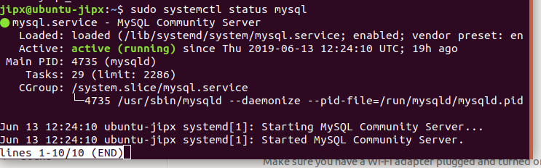
Install mysql
On Ubuntu 18.04, only the latest version of MySQL is included in the APT package repository by default. At the time of writing, that's MySQL 5.7
To install it, update the package index on your server with apt:
sudo apt update
Then install the default package:
sudo apt install mysql-server
To check if the sql-service is running: sudo systemctl status mysql

Slide 12
Create a dedicated user for PHP application to conect to a specific database
Create a user and password for your MySQL database. Your WordPress installation uses these values to communicate with your MySQL database. Enter the following command, substituting a unique user name and password.
CREATE USER 'wordpress-user'@'localhost' IDENTIFIED BY 'your_strong_password';
2. CREATE DATABASE `wordpress-db`;
3. Grant full privileges for your database to the WordPress user that you created earlier.
GRANT ALL PRIVILEGES ON `wordpress-db`.* TO "wordpress-user"@"localhost";
4. Flush the database privileges to pick up all of your changes.
5. FLUSH PRIVILEGES;

Slide 13
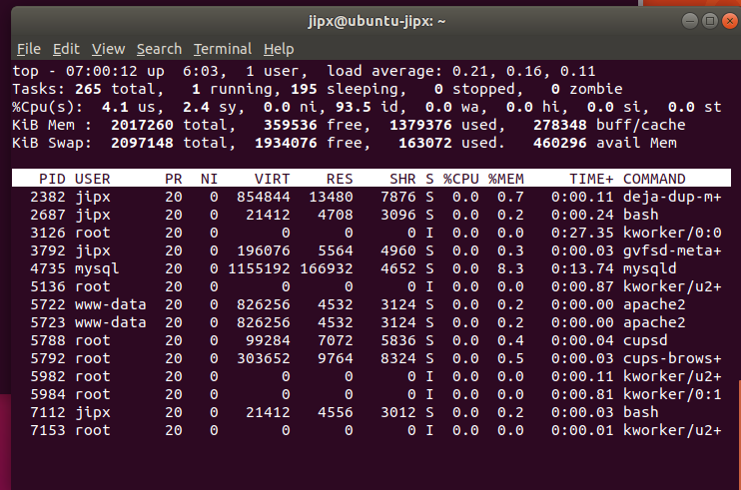
What service/process is running
Type command top

Slide 14
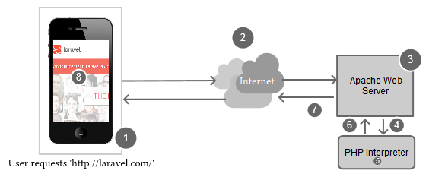
Example
Step 1
The user enters `http://laravel.com` into their browser and taps/hits 'enter'.
Step 2
After the user has tapped/hit 'enter', the browser sends the page request over the Internet to the web server.
Step 3
The web server gets the request and analyzes the request information. Apache realizes that we didn't specify a file, so it looks for a directory index and finds `index.php`.
Step 4
Since Apache knows to send files that end with the `.php` file extension to the PHP interpreter, it asks PHP to execute the file.
Step 5
In this step, PHP is executing the code contained in the `index.php` file from the request. During this step, PHP may interact with databases, the file system or make external API calls, amongst other things.
Step 6
After PHP has finished executing the `index.php` file, it sends the output back to Apache.
Step 7
Apache receives the output from PHP and sends it back over the Internet to a user's web browser. This is called the `web response`.
Step 8
The user's web browser receives the response from the server, and renders the web page on a computer or device.

Slide 15
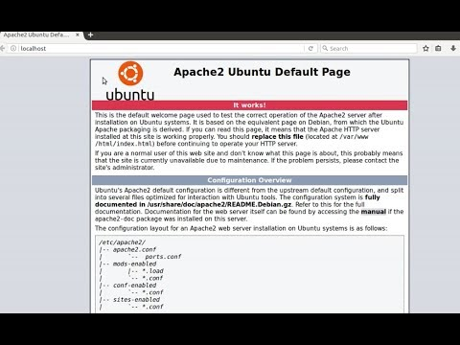
How to install apache, php, mysql & phpmyadmin

Slide 16
Manaaging the Apache Process
Now that you have your web server up and running, let's go over some basic management commands.
To stop your web server, type: sudo systemctl stop apache2 To start the web server when it is stopped, type: sudo systemctl start apache2 To stop and then start the service again, type: sudo systemctl restart apache2 If you are simply making configuration changes, Apache can often reload without dropping connections. To do this, use this command: sudo systemctl reload apache2 By default, Apache is configured to start automatically when the server boots. If this is not what you want, disable this behavior by typing:
sudo systemctl disable apache2
To re-enable the service to start up at boot, type: sudo systemctl enable apache2

Slide 17
Write permission set for web master
The following example grants shared write permission to /var/www/html to the group "webmasters".
sudo chgrp -R webmasters /var/www/html
sudo find /var/www/html -type d -exec chmod g=rwxs "{}" \;
sudo find /var/www/html -type f -exec chmod g=rw "{}" \;
These commands recursively set the group permission on all files and directories in /var/www/html to read write and set user id. This has the effect of having the files and directories inherit their group and permission from their parrent. Many admins find this useful for allowing multiple users to edit files in a directory tree.
https://help.ubuntu.com/lts/serverguide/httpd.html.en-GB#http-directory-permissions

Slide 18
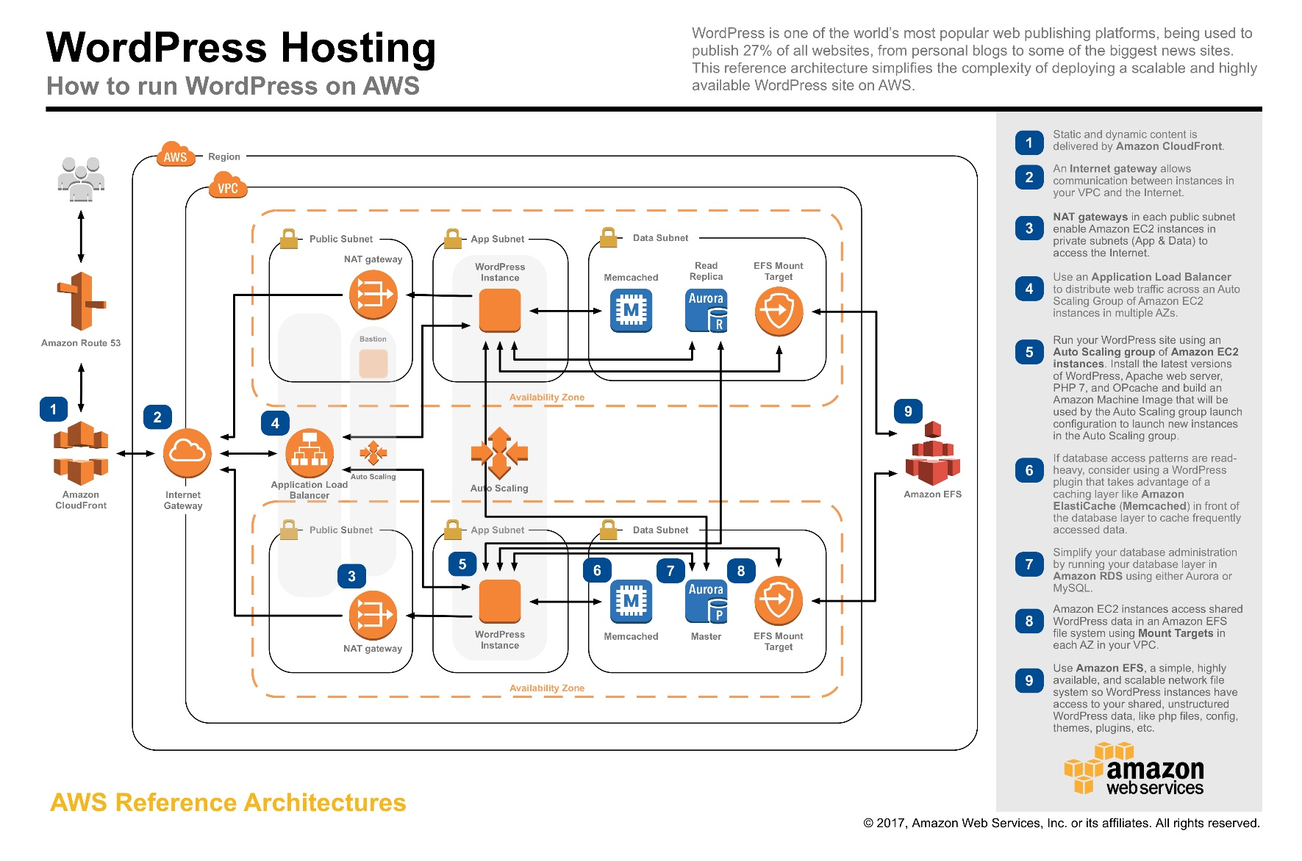
Cloud Application

Slide 19
Summary
HTTPd

